Slide 1
Backtracking

Slide 2

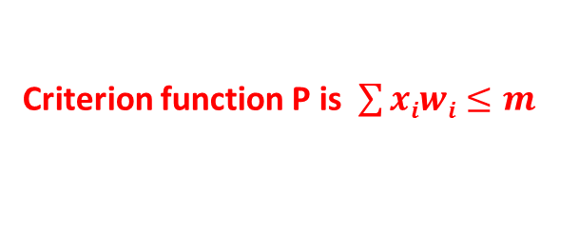
BACKTRACKING
Principal
Problems searching for a set of solutions or which require an optimal solution can be solved using the backtracking method .
To apply the backtrack method, the solution must be expressible as an n-tuple(x₁,…,x_{n}), where the x_{i} are chosen from some finite set s_{i}
The solution vector must satisfy the criterion function P(x₁ , ….. , x_{n}).
For a 0/1 knapsack problem (x1,x2,x3,x4)=(1,0,0,1)
Criterion function P is $\sum{xiwi≤m }$

Slide 3
BACKTRACKING (Contd..)
Suppose there are m n-tuples which are possible candidates for satisfying the function P.
Then m= m₁, m₂…..m_{n} where m_{i} is size of set s_{i} 1<=i<=n.
The brute force approach would be to form all of these n-tuples and evaluate each one with P, saving the optimum.

Slide 4
BACKTRACKING (Contd..)
The backtracking algorithm has the ability to yield the same answer with far fewer than m-trials.
In backtracking, the solution is built one component at a time.
Modified criterion functions P_{i} (x₁...x_{n}) called bounding functions are used to test whether the partial vector (x₁,x₂,......,x_{i}) can lead to an optimal solution.
If (x₁,...x_{i}) is not leading to a solution, m_{i+1},....,m_{n} possible test vectors may be ignored.

Slide 5
BACKTRACKING – Constraints
EXPLICIT CONSTRAINTS are rules which restrict the values of x_{i.}
Examples x_{i} ≥ 0 or x_{i}= 0 or 1 or l_{i} ≤ x_{i} ≤ u_{i.}
IMPLICIT CONSTRAINTS describe the way in which the x_{i} must relate to each other .
Example : 8 queens problem.

Slide 6
BACKTRACKING: Solution Space
Tuples that satisfy the explicit constraints define a solution space.
The solution space can be organized into a tree. Each node in the tree defines a problem state.
All paths from the root to other nodes define the state-space of the problem.
Solution states are those states leading to a tuple in the solution space.
Answer nodes are those solution states leading to an answer-tuple (i.e. tuples which satisfy implicit constraints).

Slide 7
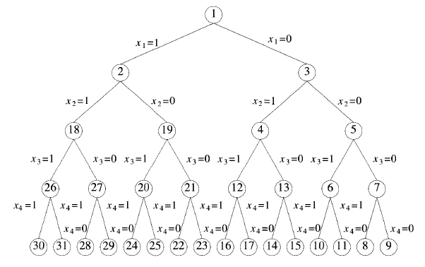
BACKTRACKING: Solution Space
If weights of 4 items are 10,20,30,50 and knapsack capacity is 70
(x₁,x₂,x₃,x₄)=(1,1,1,0) Answer node
(x₁,x₂,x₃,x₄)=(1,1,1,1) solution space
Problem state
State space
(x₁,x₂,x₃)=(1,1,1)
Solution States
(x₁,x₂,x₃,x₄)=
(1,1,1,1)

Slide 8
BACKTRACKING -Terminology
LIVE NODE A node which has been generated and all of whose children are not yet been generated .
E-NODE (Node being expanded) - The live node whose
children are currently being generated .
DEAD NODE - A node that is either not to be expanded further, or for which all of its children have been generated
DEPTH FIRST NODE GENERATION- In this, as soon as a new child C of the current E-node R is generated, C will become the new E-node.

Slide 10
BACKTRACKING -Terminology
Static trees: the tree organizations are independent of the problem instance being solved

Slide 11
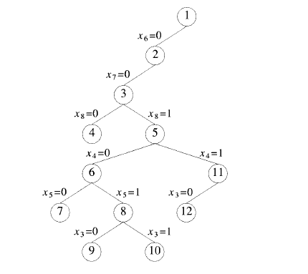
BACKTRACKING -Terminology
Dynamic trees: Tree organizations that are problem instance dependent

Slide 12
BACKTRACKING -Terminology
BOUNDING FUNCTION - will be used to kill live nodes without generating all their children.
BACTRACKING-is depth – first node generation with bounding functions.
BRANCH-and-BOUND- is a method in which E-node remains E-node until it is dead.

Slide 13
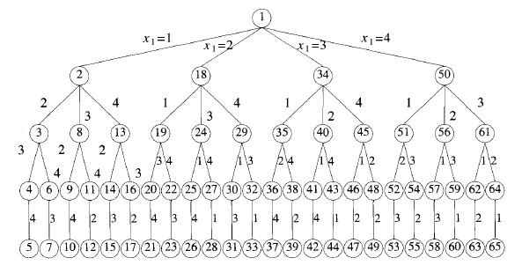
BACKTRACKING -Terminology
BACTRACKING-is depth – first node generation with bounding functions.
DEPTH FIRST NODE GENERATION- In this, as soon as a new child C of the current E-node R is generated, C will become the new E-node.

Slide 14
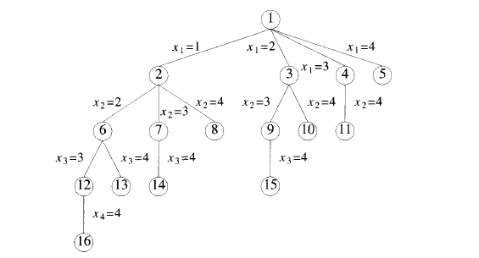
Branch and Bound -Terminology
BREADTH-FIRST-SEARCH : Branch-and Bound with each new node placed in a queue .The front of the queen becomes the new E-node.

Slide 15
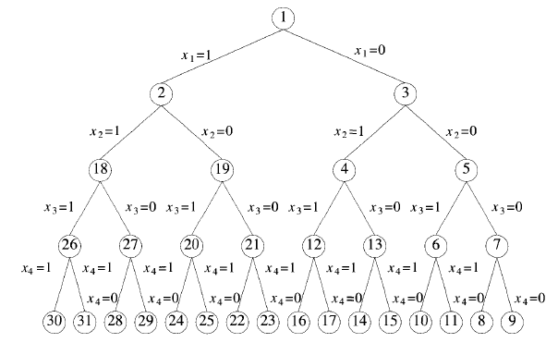
Branch and Bound -Terminology
DEPTH-SEARCH (D-Search) : New nodes are placed in to a stack.The last node added is the first to be explored.

Slide 16
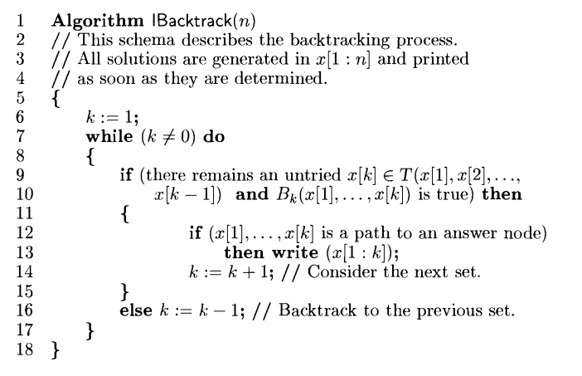
Iterative Control Abstraction
( General Backtracking Method)

Slide 17
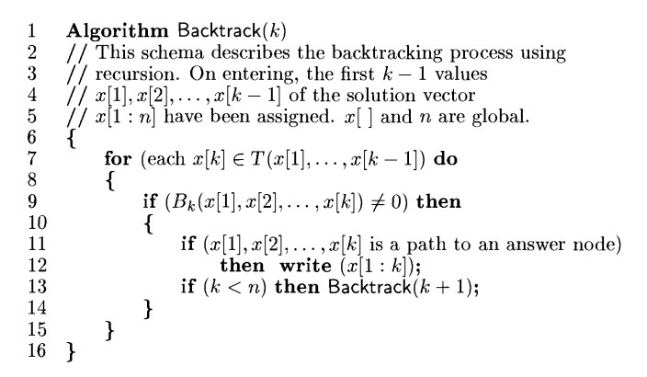
Recursive Control Abstraction
( General Backtracking Method)

Slide 18
EFFICIENCY OF BACKTRACKING
ALGORITHM Depend on 4 Factors
The time to generate the next X(k)
The no. of X(k) satisfying the explicit constraints
The time for bounding functions B_{i}
The no. of X(k) satisfying the B_{i} for all i

